Slide 1
Joint Committee on Volunteer Fire Departments and Emergency Medical Services
EMS Minimum Staffing Requirements

Slide 2
EMS Response Data
The following information is from October 2022 to October 2023
911 Response (Scene) | Interfacility Transport | Medical Transport | Grand Total
228484 | 44820 | 147614 | 420918
Response dispatched every 48 seconds
911 Response every 2 minutes 18 seconds
Interfacility Response 122.7 per day
Medical Transports 404 per day

Slide 3
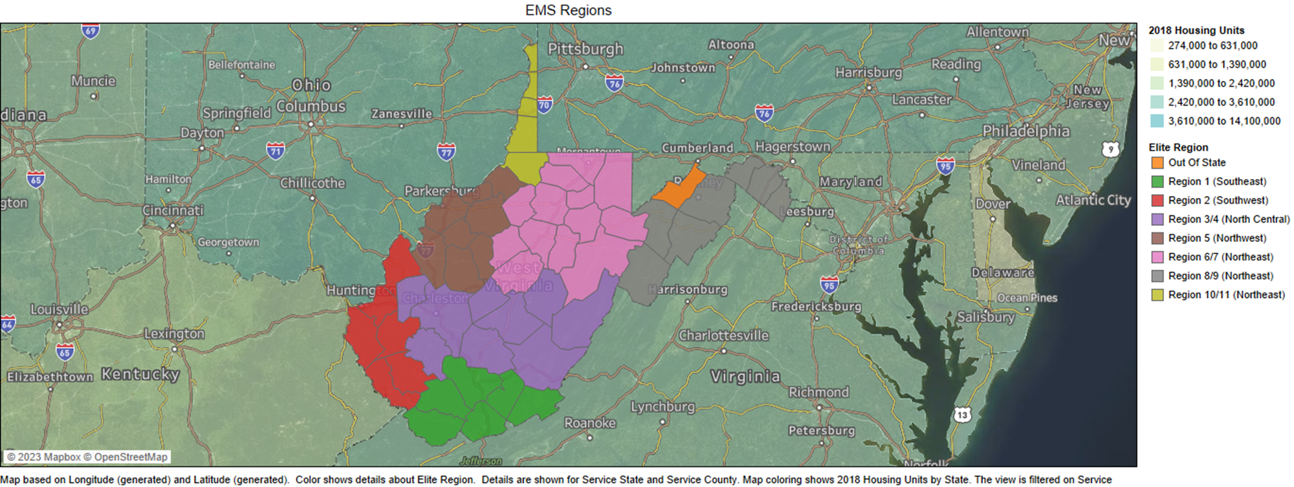
EMS Services and Regions
EMS Services and WV Regions

Slide 4
Vehicle and Staff Requirements
911 Only Minimum Vehicles per County
County | Population | 2023 Response Volume | Vehicles Required
Barbour County | 15,414 | 1979 | 3
Berkeley County | 129,490 | 18427 | 15
Boone County | 20,968 | 5121 | 3
Braxton County | 12,185 | 1989 | 2
Brooke County | 21,733 | 3357 | 3
Cabell County | 92,730 | 24187 | 11

Slide 5
Response Time
911 Responses
Best Average Response Time (minute)
County | Average Response Min | Rank
Ohio | 8.61 | 1
Jefferson | 11.36 | 2
Hancock | 11.84 | 3
Berkeley | 12.53 | 4
Kanawha | 16.32 | 5
Ambulance response time is measured as the time (in minutes) between the initial call to emergency medical services (EMS) and when the patient is reached by ambulance.
Worst Average Response Time (minute)
County | Average Response Time | Rank
Wirt | 32.70 | 51
McDowell | 34.44 | 52
Summers | 39.37 | 53
Clay | 47.34 | 54
Pendleton | 50.33 | 55

Slide 6
Time on Task
911 Responses
Best Time on Task(minute)
County | Median Time on Task (TOT) | Rank
Upshur | 33 | 1
Wood | 36 | 2
Hancock | 43 | 3
Randolph | 45 | 4
Berkeley | 45.3 | 5
Time on Task is measured in minutes as the time from when an ambulance begins its response to the time when the ambulance is available to respond to another call
Worst Time on Task(minute)
County | Median Time on Task (TOT) | Rank
Pleasants | 212 | 51
Doddridge | 115 | 52
Ritchie | 115 | 53
Wyoming | 114 | 54
Pendleton | 105 | 55

Slide 7
Mutual Aid
Mutual Aid Given and by County

Slide 8
Reimbursement

Slide 9
Reimbursement Example
Assumes a routine 911 Chest pain call transported 16 miles (average).
ALS Treatment:
Oxygen
Nitroglycerin
intravenous line
12-Lead electrocardiogram
Pain Management (Fentanyl or Morphine)
BLS Treatment:
Oxygen
Nitroglycerin
12-Lead electrocardiogram

Slide 10
Contact
Joseph “Jody” Ratliff, BA, FP-C
Director WV Office of Emergency Medical Services
350 Capital Street, Charleston WV 25302
Phone: 304-558-3956
Fax: 304-558-3856
Email: joseph.w.Ratliff@wv.gov

